Slide 2

Shader Profiling and Optimization

Slide 3
Arturo Núñez Product Evangelist, Unity Technologies

Slide 4
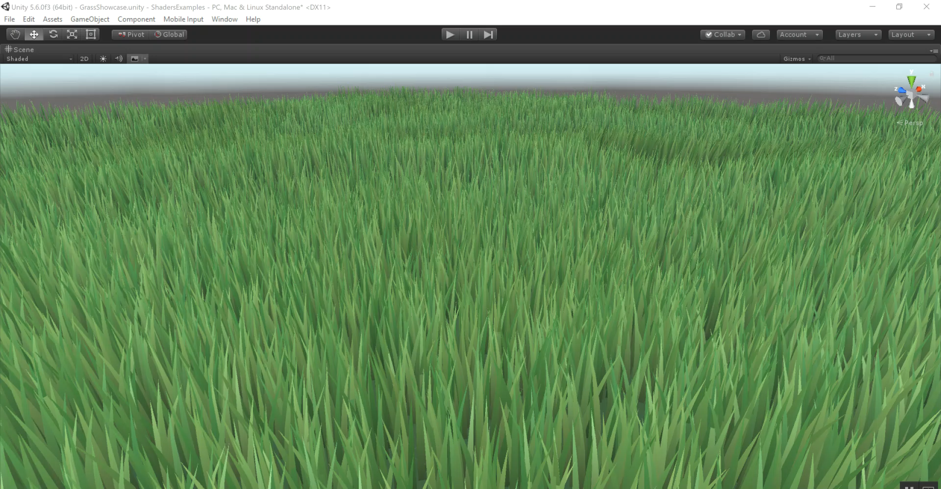

Slide 5
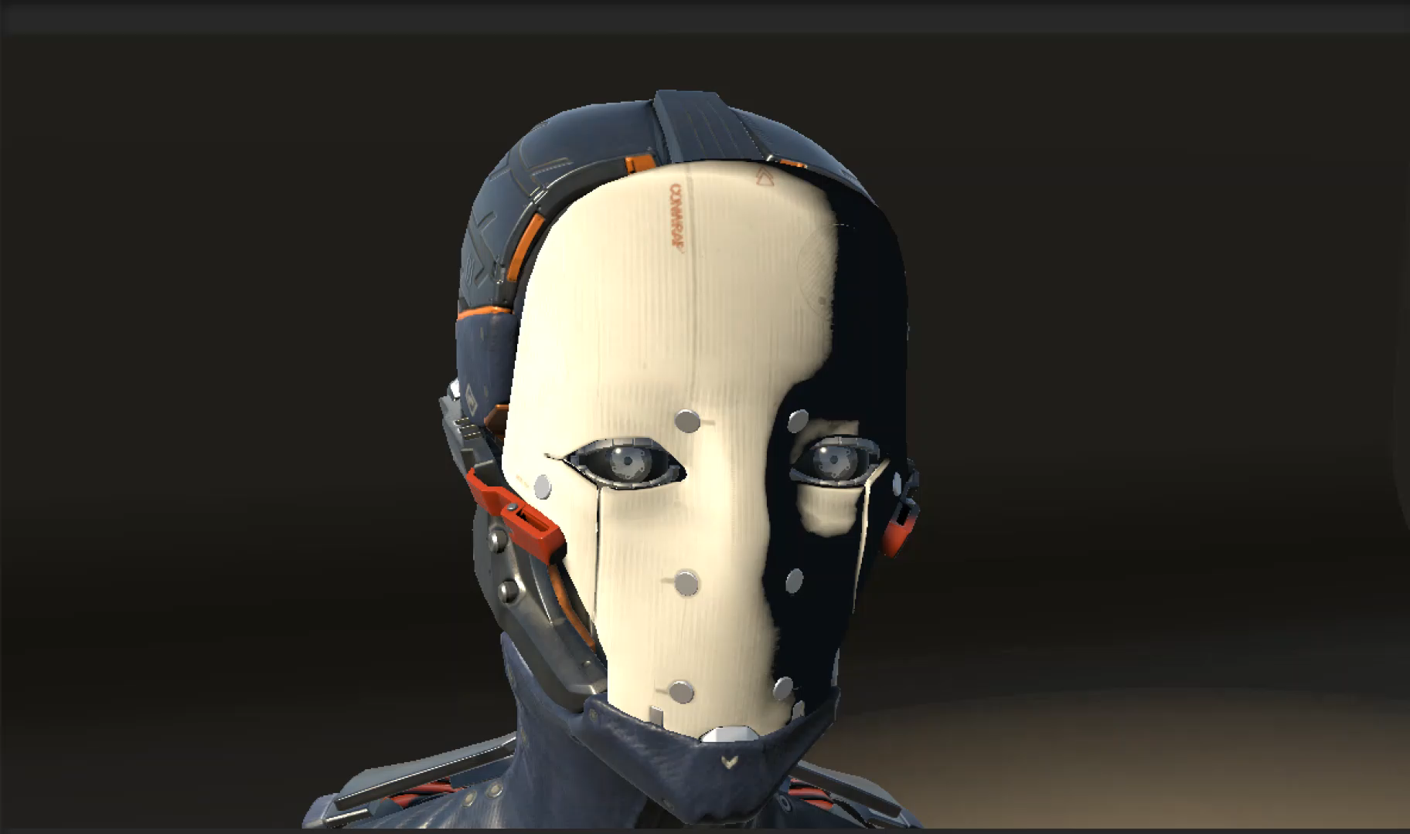

Slide 6
Rendering Pipeline - A Basic Overview
Assets (mesh vertices, textures) sent to GPU
Prepare to Render - Send updated transforms etc. to GPU
Render to FBO - Run Vert/Frag shaders on GPU
Blit Framebuffer to Screen
(Not necessarily done every frame)
(Typically happens every frame)

Slide 7



Shaders - What is Vertex Shader? Fragment Shader?
Vertex shaders run on every vertex of every mesh in the Camera frustrum
Pixel shaders run on every pixel that lies inside the visible triangles of your mesh
Vertex Shader
Pixel Shader
Vertex Shader
Pixel Shader
Interpolation and Rasterization
Interpolation and Rasterization

Slide 8
Headline can go in two lines if necessary and will center-align vertically.
First level. Class aptenttacitisociosqu ad litoratorquent per conubia nostra, per inceptoshymenaeos.
Second level. Nam quam nunc, blanditvel, luctuspulvinar, hendrerit id, lorem.
Morbi ac felis. Phasellusnecsem in justopellentesquefacilisis.
Nullamnullaeros, ultricies sit amet.
Collaboratively brand fully tested expertise and distinctive meta-services.
Professionally alternative ROI rather than vertical best practices.
Proactively evisculate clicks-and-mortar human capital through state of the art users.

Slide 10
Thank you!

